Slide 2
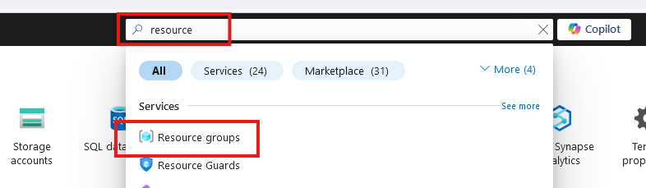
Create Resource Group

Slide 3
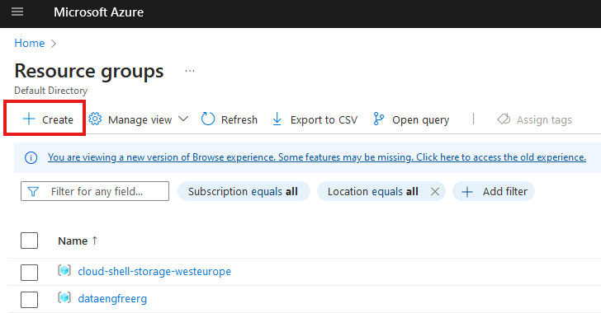
Create Resource Group

Slide 4
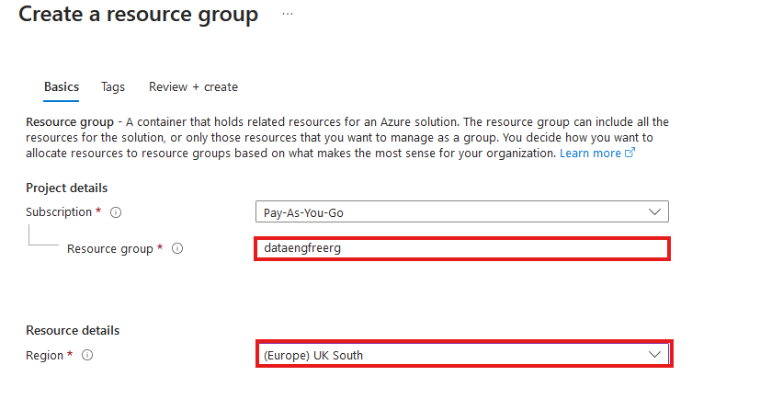
Create Resource Group

Slide 5
VS Code

Slide 6
Azure CLI
Install by following links from: https://learn.microsoft.com/en-us/cli/azure/install-azure-cli
For VSCode:
Azure CLI Tools
Azure Developer CLI
CLI will require extensions for some commands
Automatically downloaded

Slide 7
Azure CLI Demo

Slide 8
Create storage account
Create in same region as RG
Primary service is ADLS Gen 2
Primary workload Big Data Analytics
Performance: Standard
Redundancy: LRS
Add container > RAW directory

Slide 9
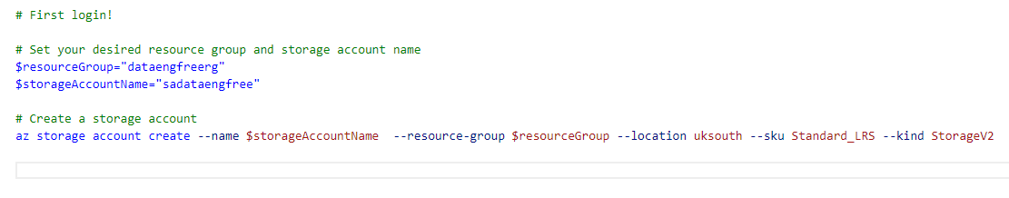
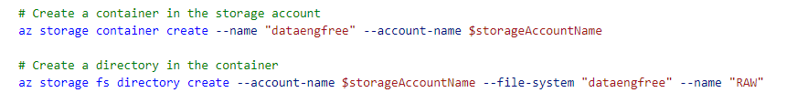
Create storage account

Slide 10
Data & Databases
Concepts to Learn: Data types, databases (SQL and NoSQL), data structures.
Tools/Resources:
Azure SQL Database - free tier available
Cosmos DB: Explore NoSQL databases with a limited free tier on Azure.

Slide 11
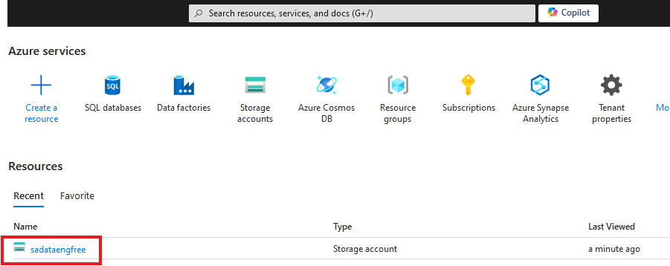

Slide 12
Create Azure Data Factory
Create in same region as RG

Slide 13
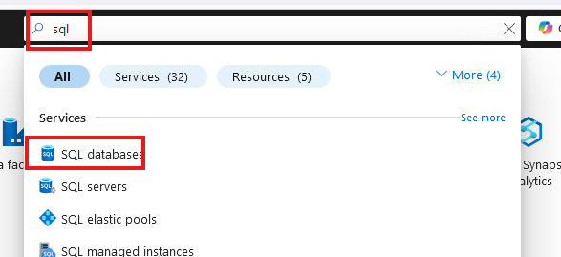
Create SQL database

Slide 14
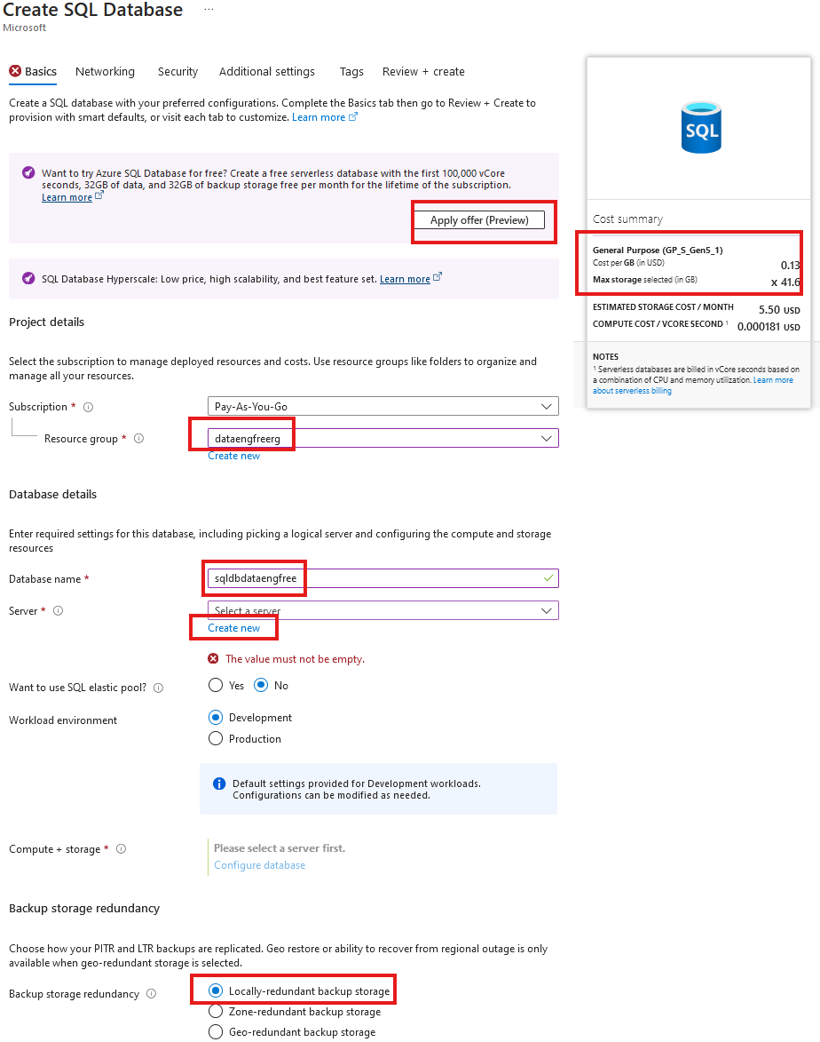
Create SQL database

Slide 15
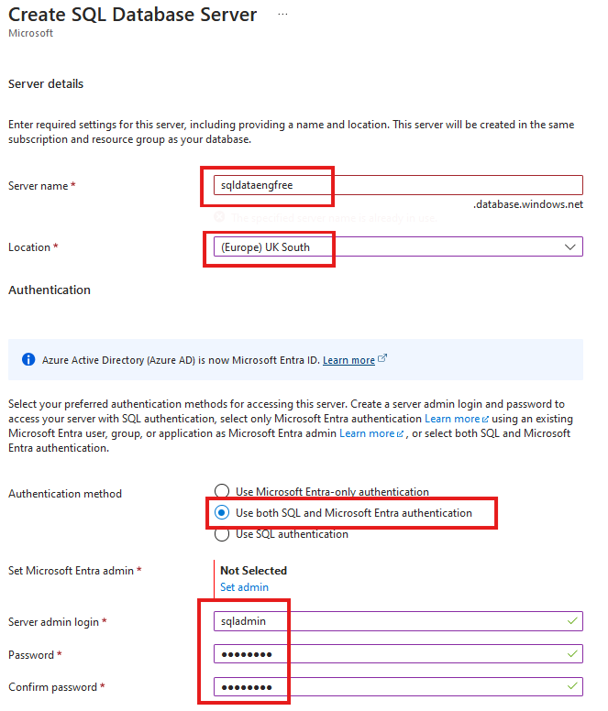
Create SQL database

Slide 16
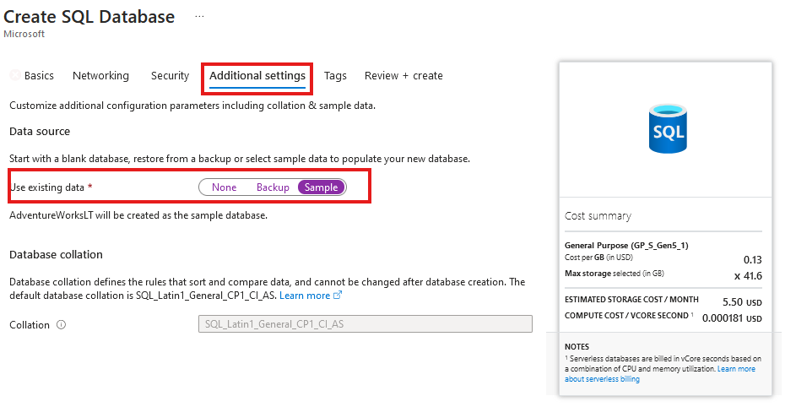
Create SQL database
Add sample data

Slide 17
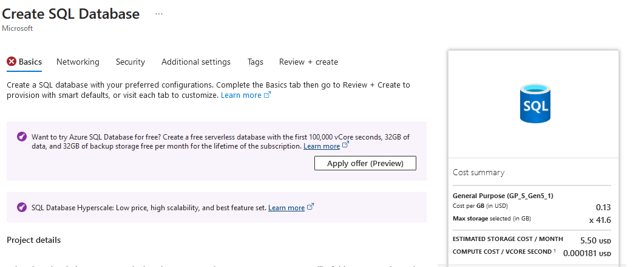

Slide 18
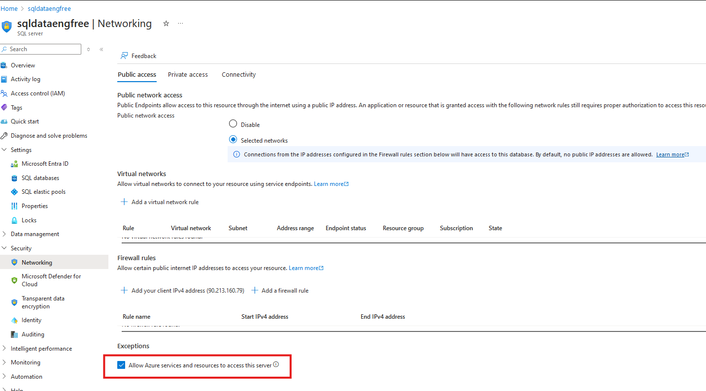

Slide 19
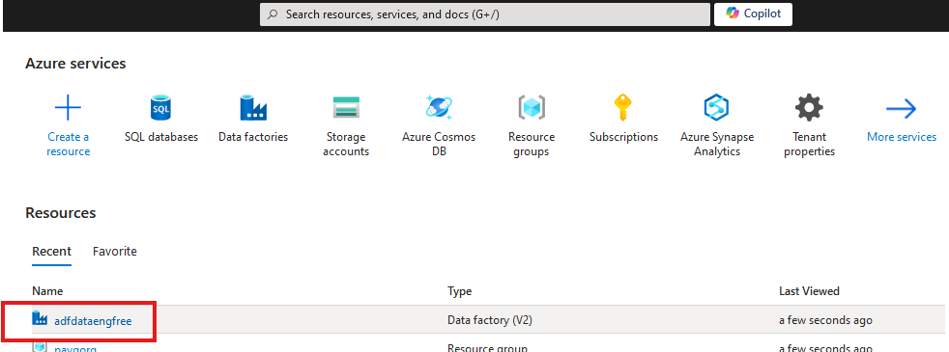
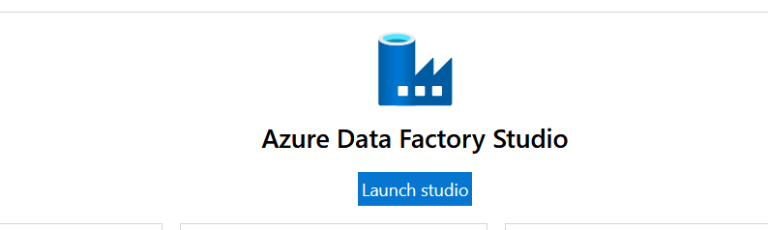

Slide 20
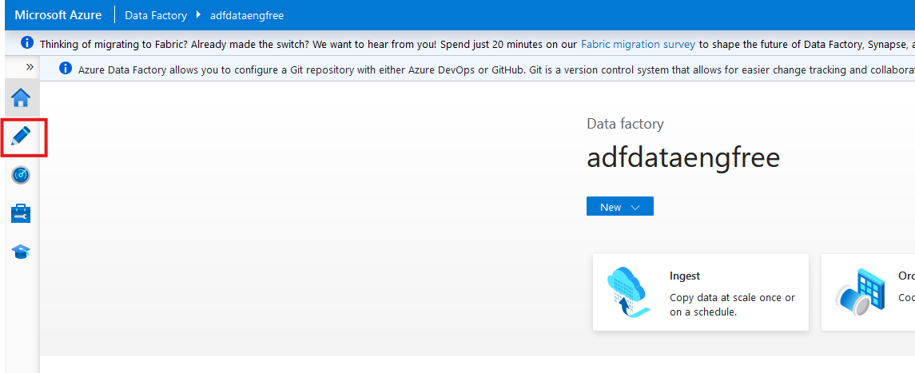

Slide 21
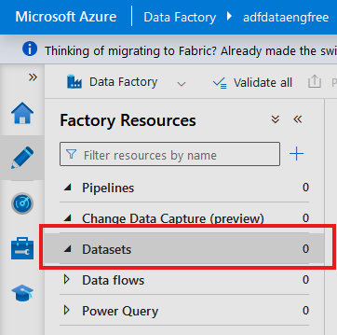
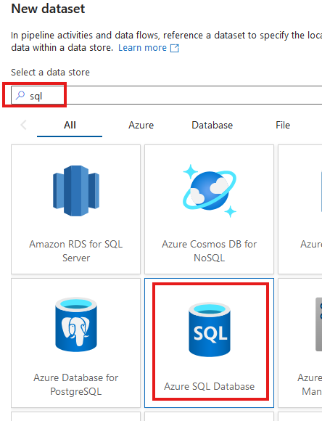

Slide 22
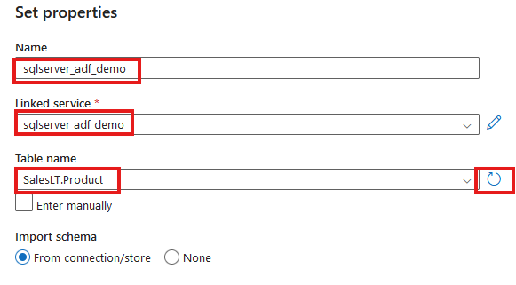

Slide 23
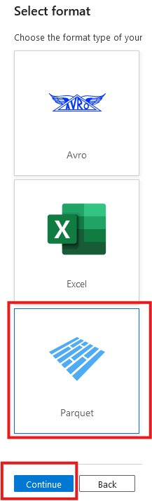
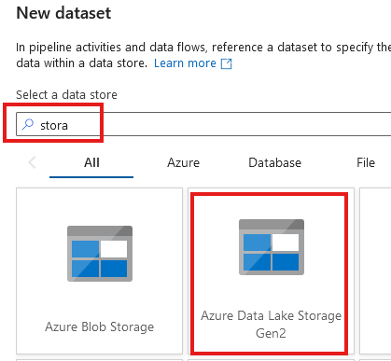

Slide 24
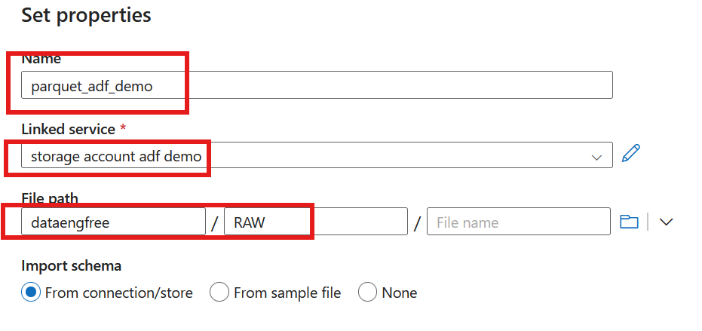

Slide 25
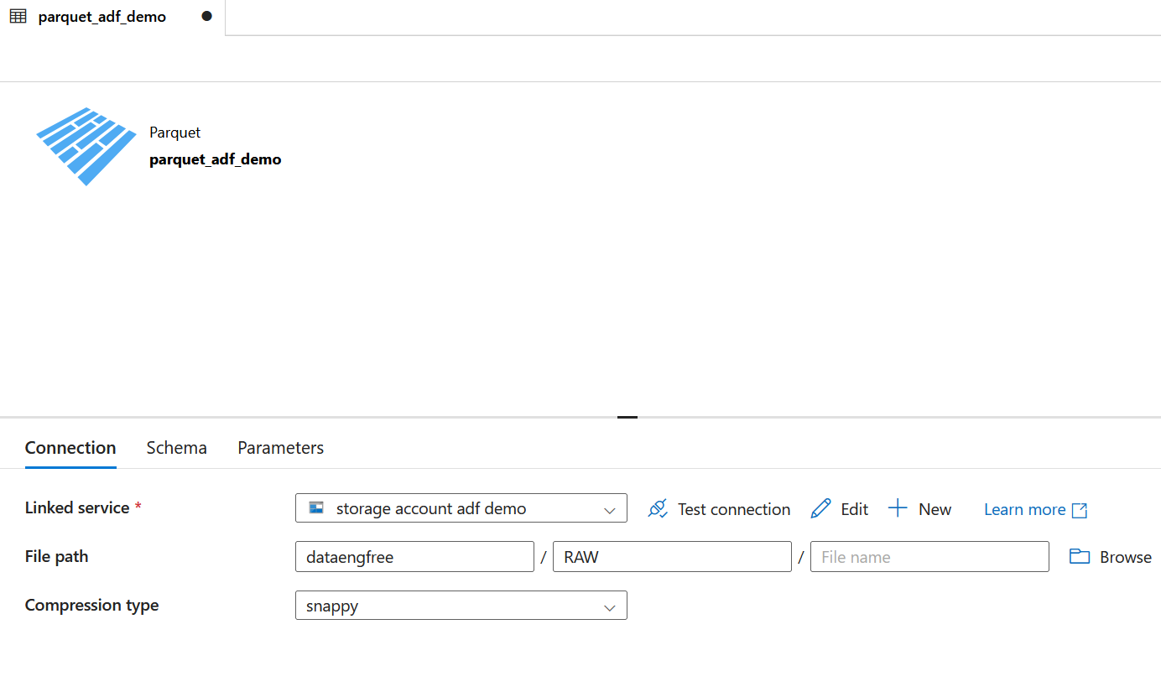

Slide 26
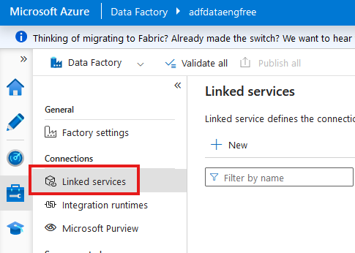

Slide 27
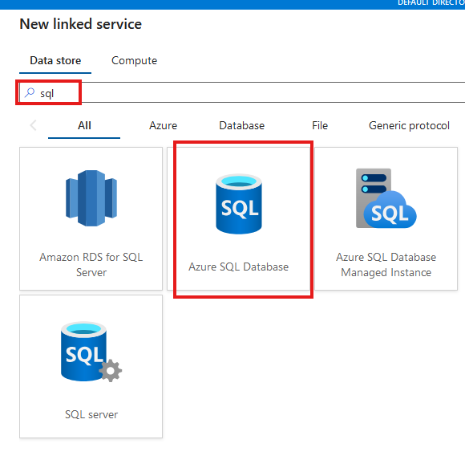

Slide 28
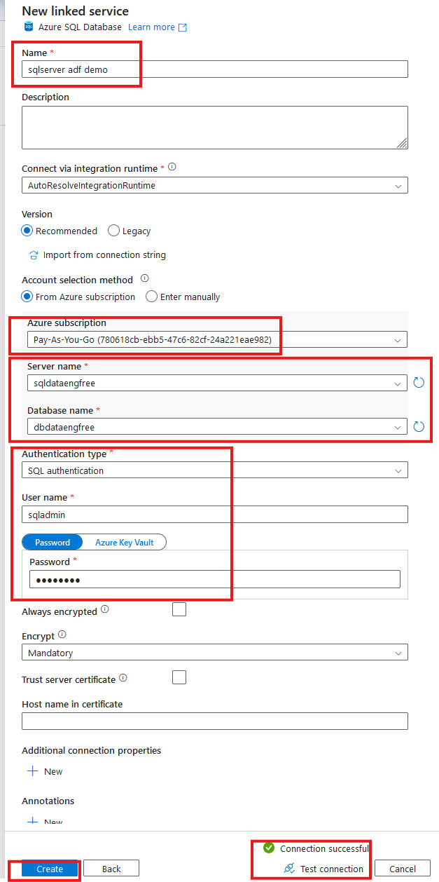

Slide 29
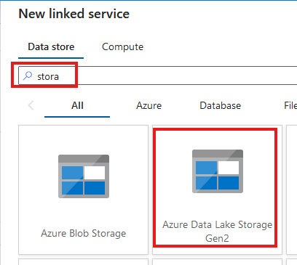
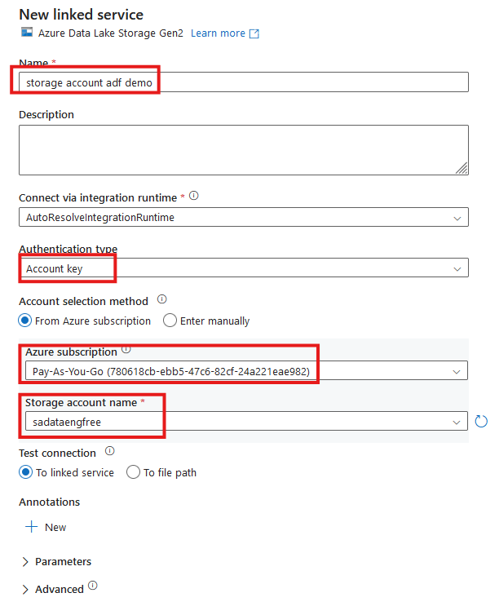


Slide 30
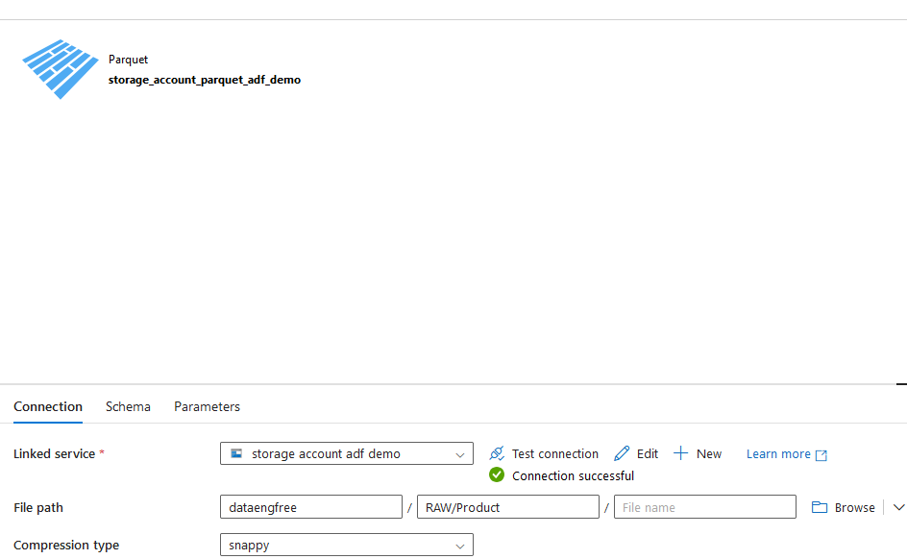

Slide 31
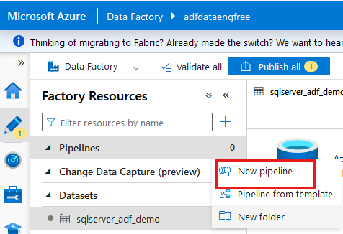
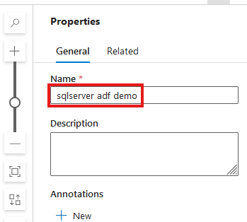

Slide 32
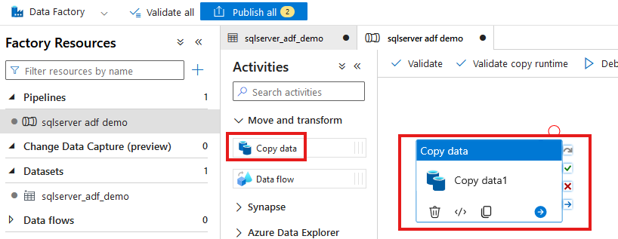

Slide 33
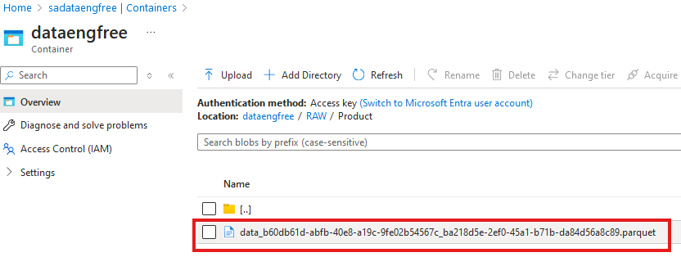

Slide 34
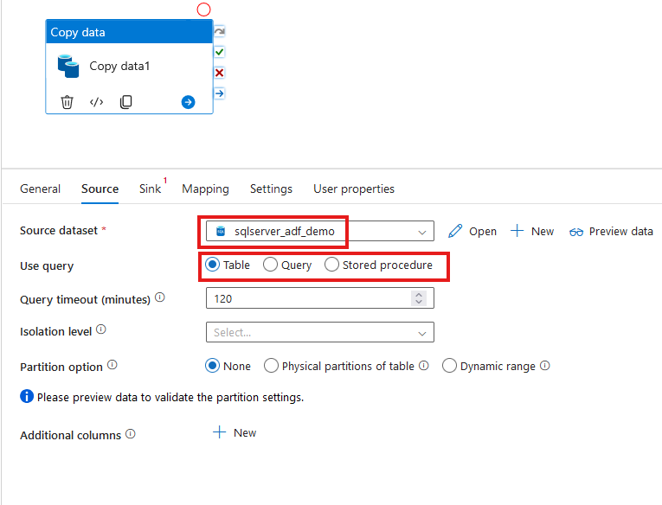

Slide 35
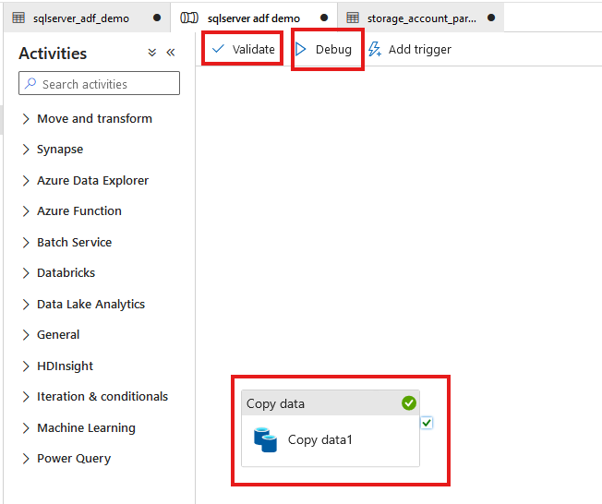

Slide 36
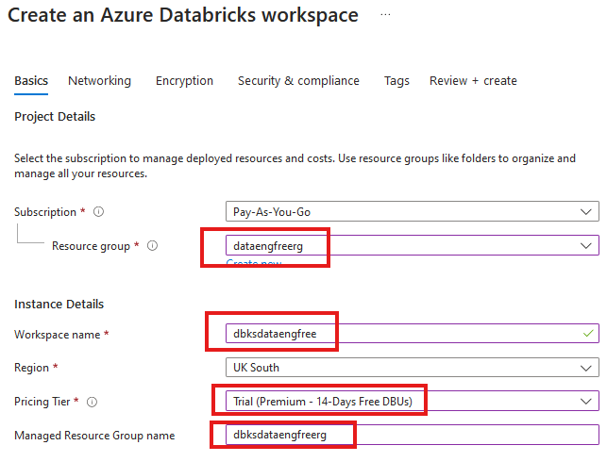


Slide 37
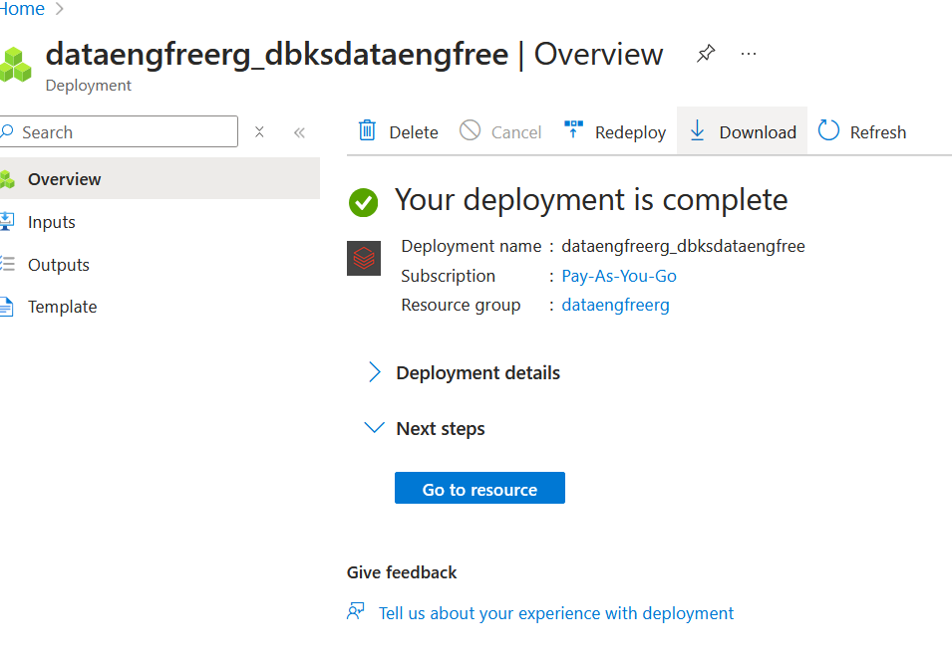

Slide 38
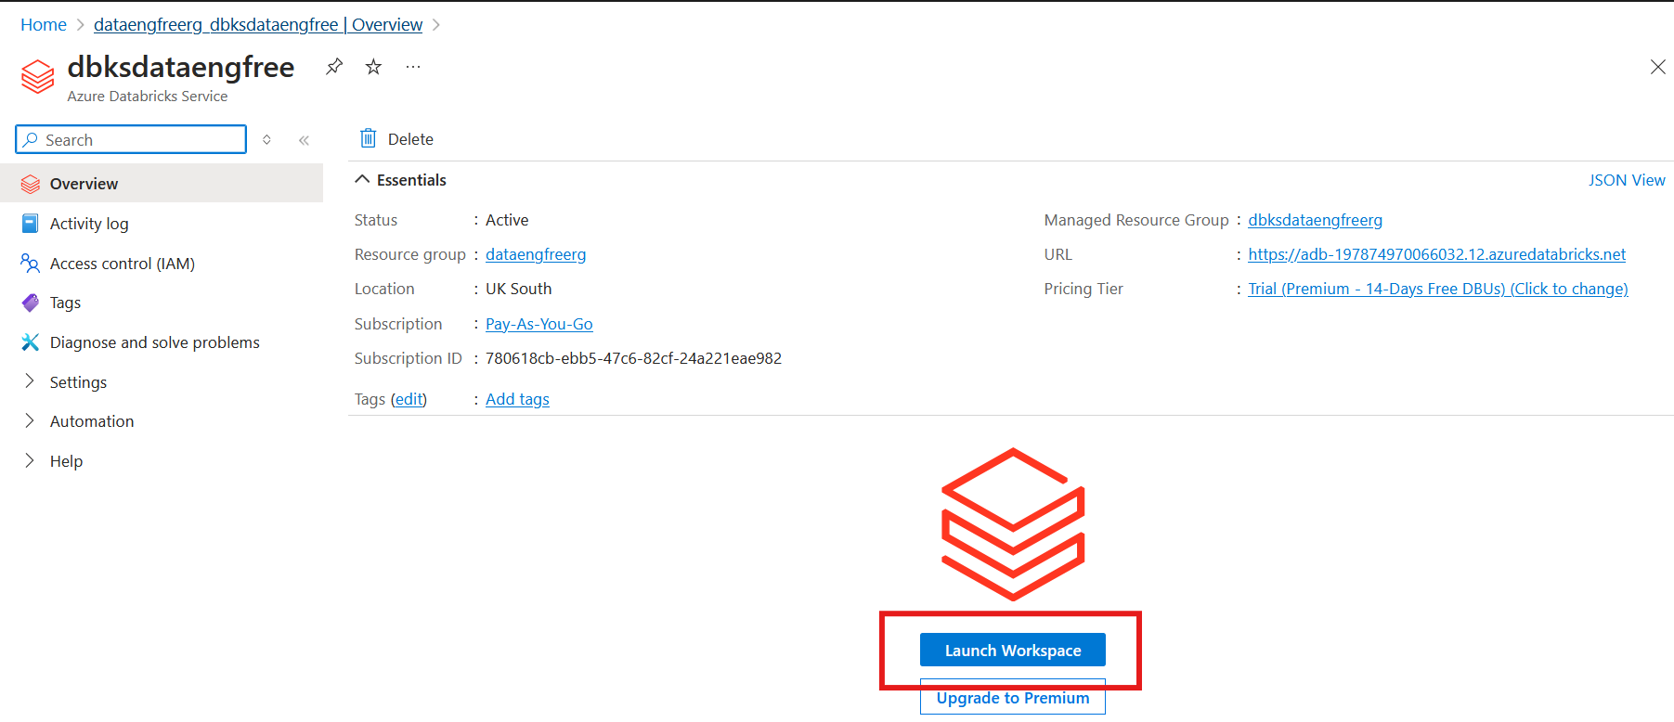

Slide 39
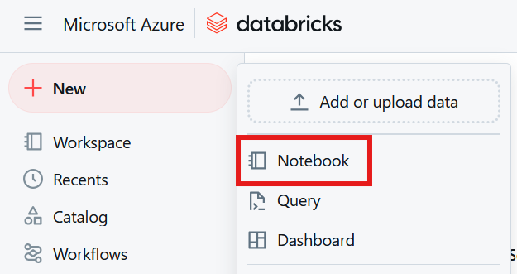

Slide 40
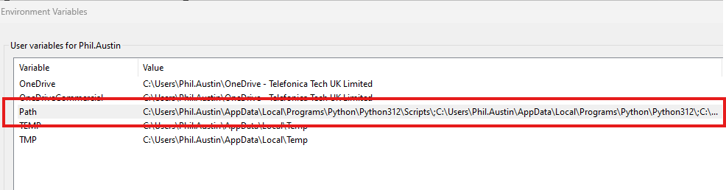
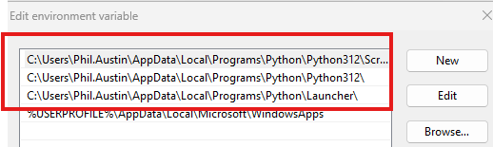
Python pre-reqs

Slide 41
Python Demo
Install Anaconda
Use conda to create

Slide 42
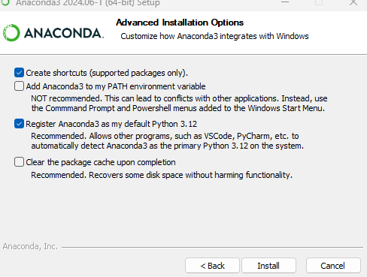

Slide 43
PySpark Pre-requisites
Install Java (not v 21)
Set paths
JAVA_HOME
PATH
Install Apache Spark
Install winutils.exe
Create virtual environment
Instructions: https://sparkbyexamples.com/pyspark-tutorial/

Slide 44
PySpark Demo
Notes:
PySpark validation
Web UI
VS Code
- to run Jupiter notebooks needs ipykernel installed
- from vscode run conda install -n dataengforfree_env ipykernel
- copy python.exe > python3.exe
Visualisation?

Slide 45
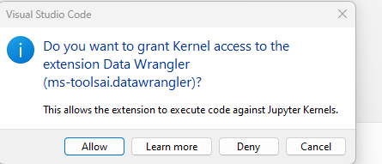

Slide 46
END

Slide 47
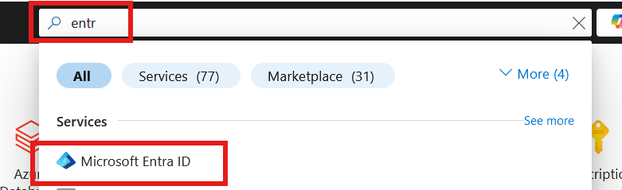
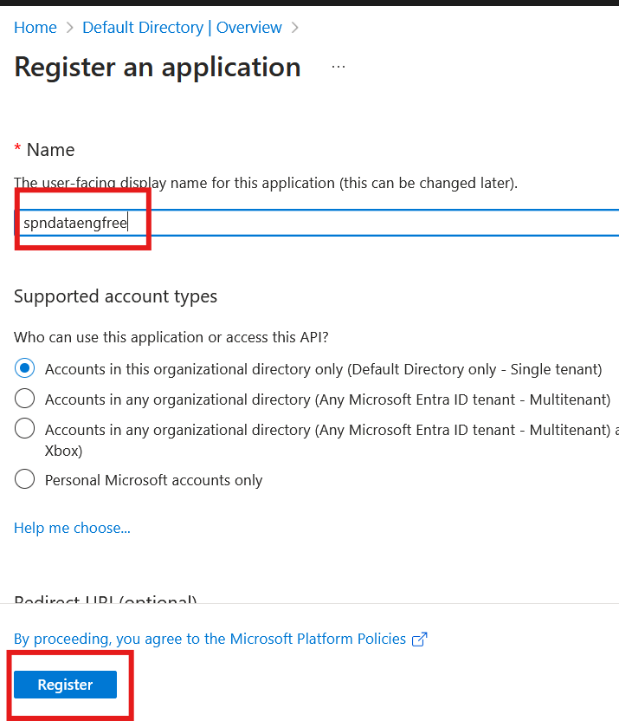

Slide 48
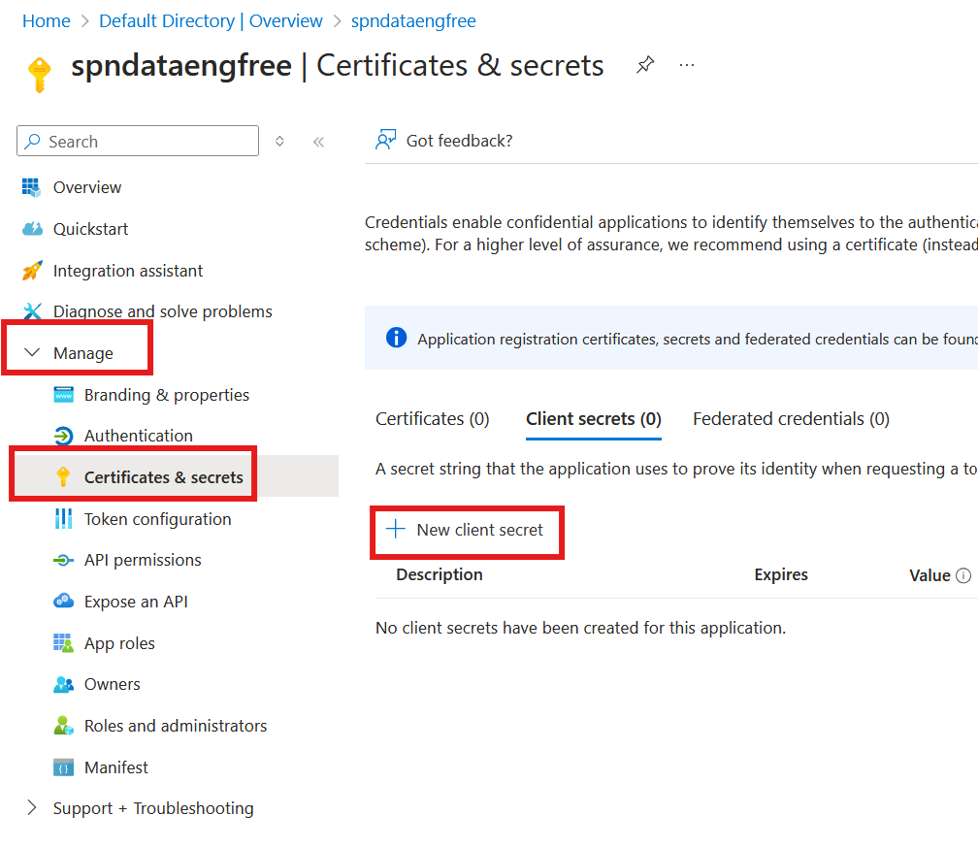
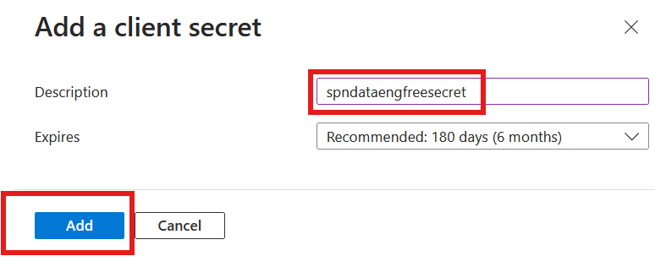

Slide 49
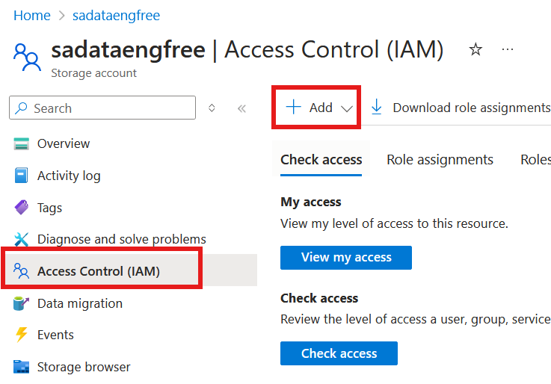
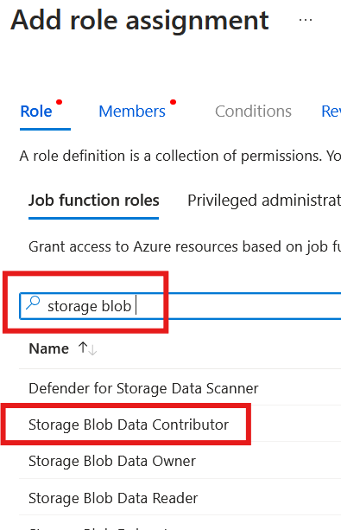

Slide 50
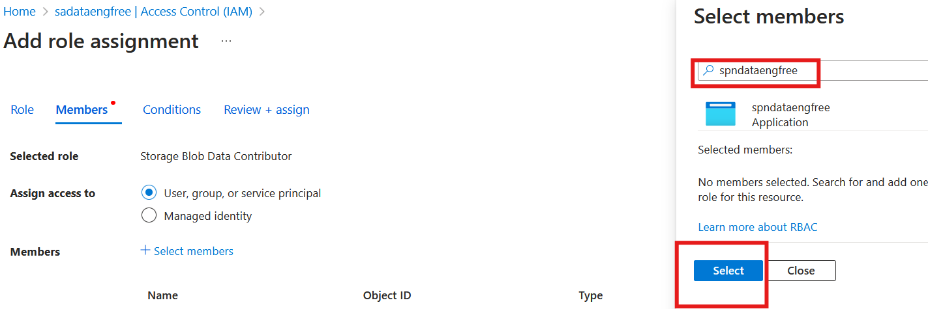

Slide 51
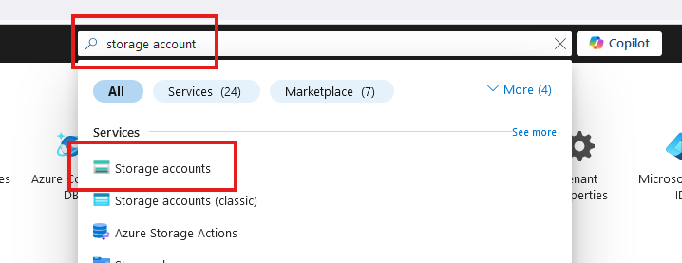
Create storage account

Slide 52

Create storage account

Slide 53

Create storage account

Slide 54



Slide 55


Create Azure Data Factory (ADF)

Slide 56
Create Azure Data Factory (ADF)

Slide 57

Create Azure Data Factory (ADF)

Slide 58


Slide 60
PySpark

